Slide 1
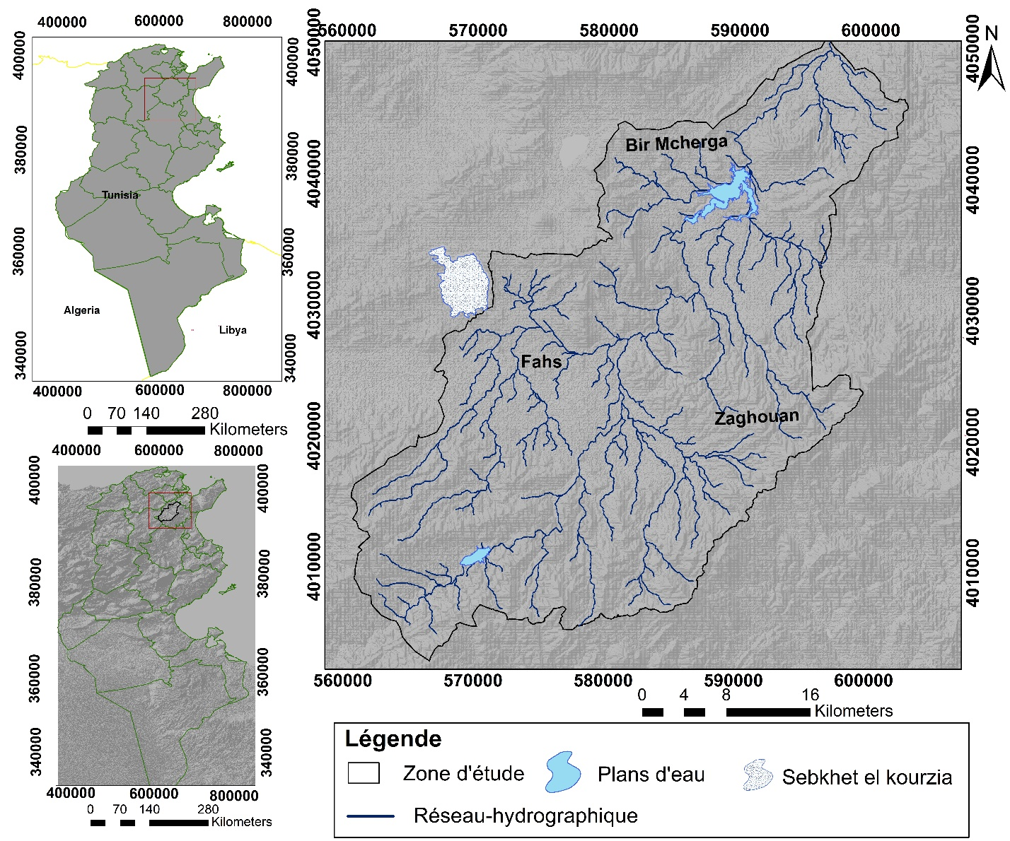
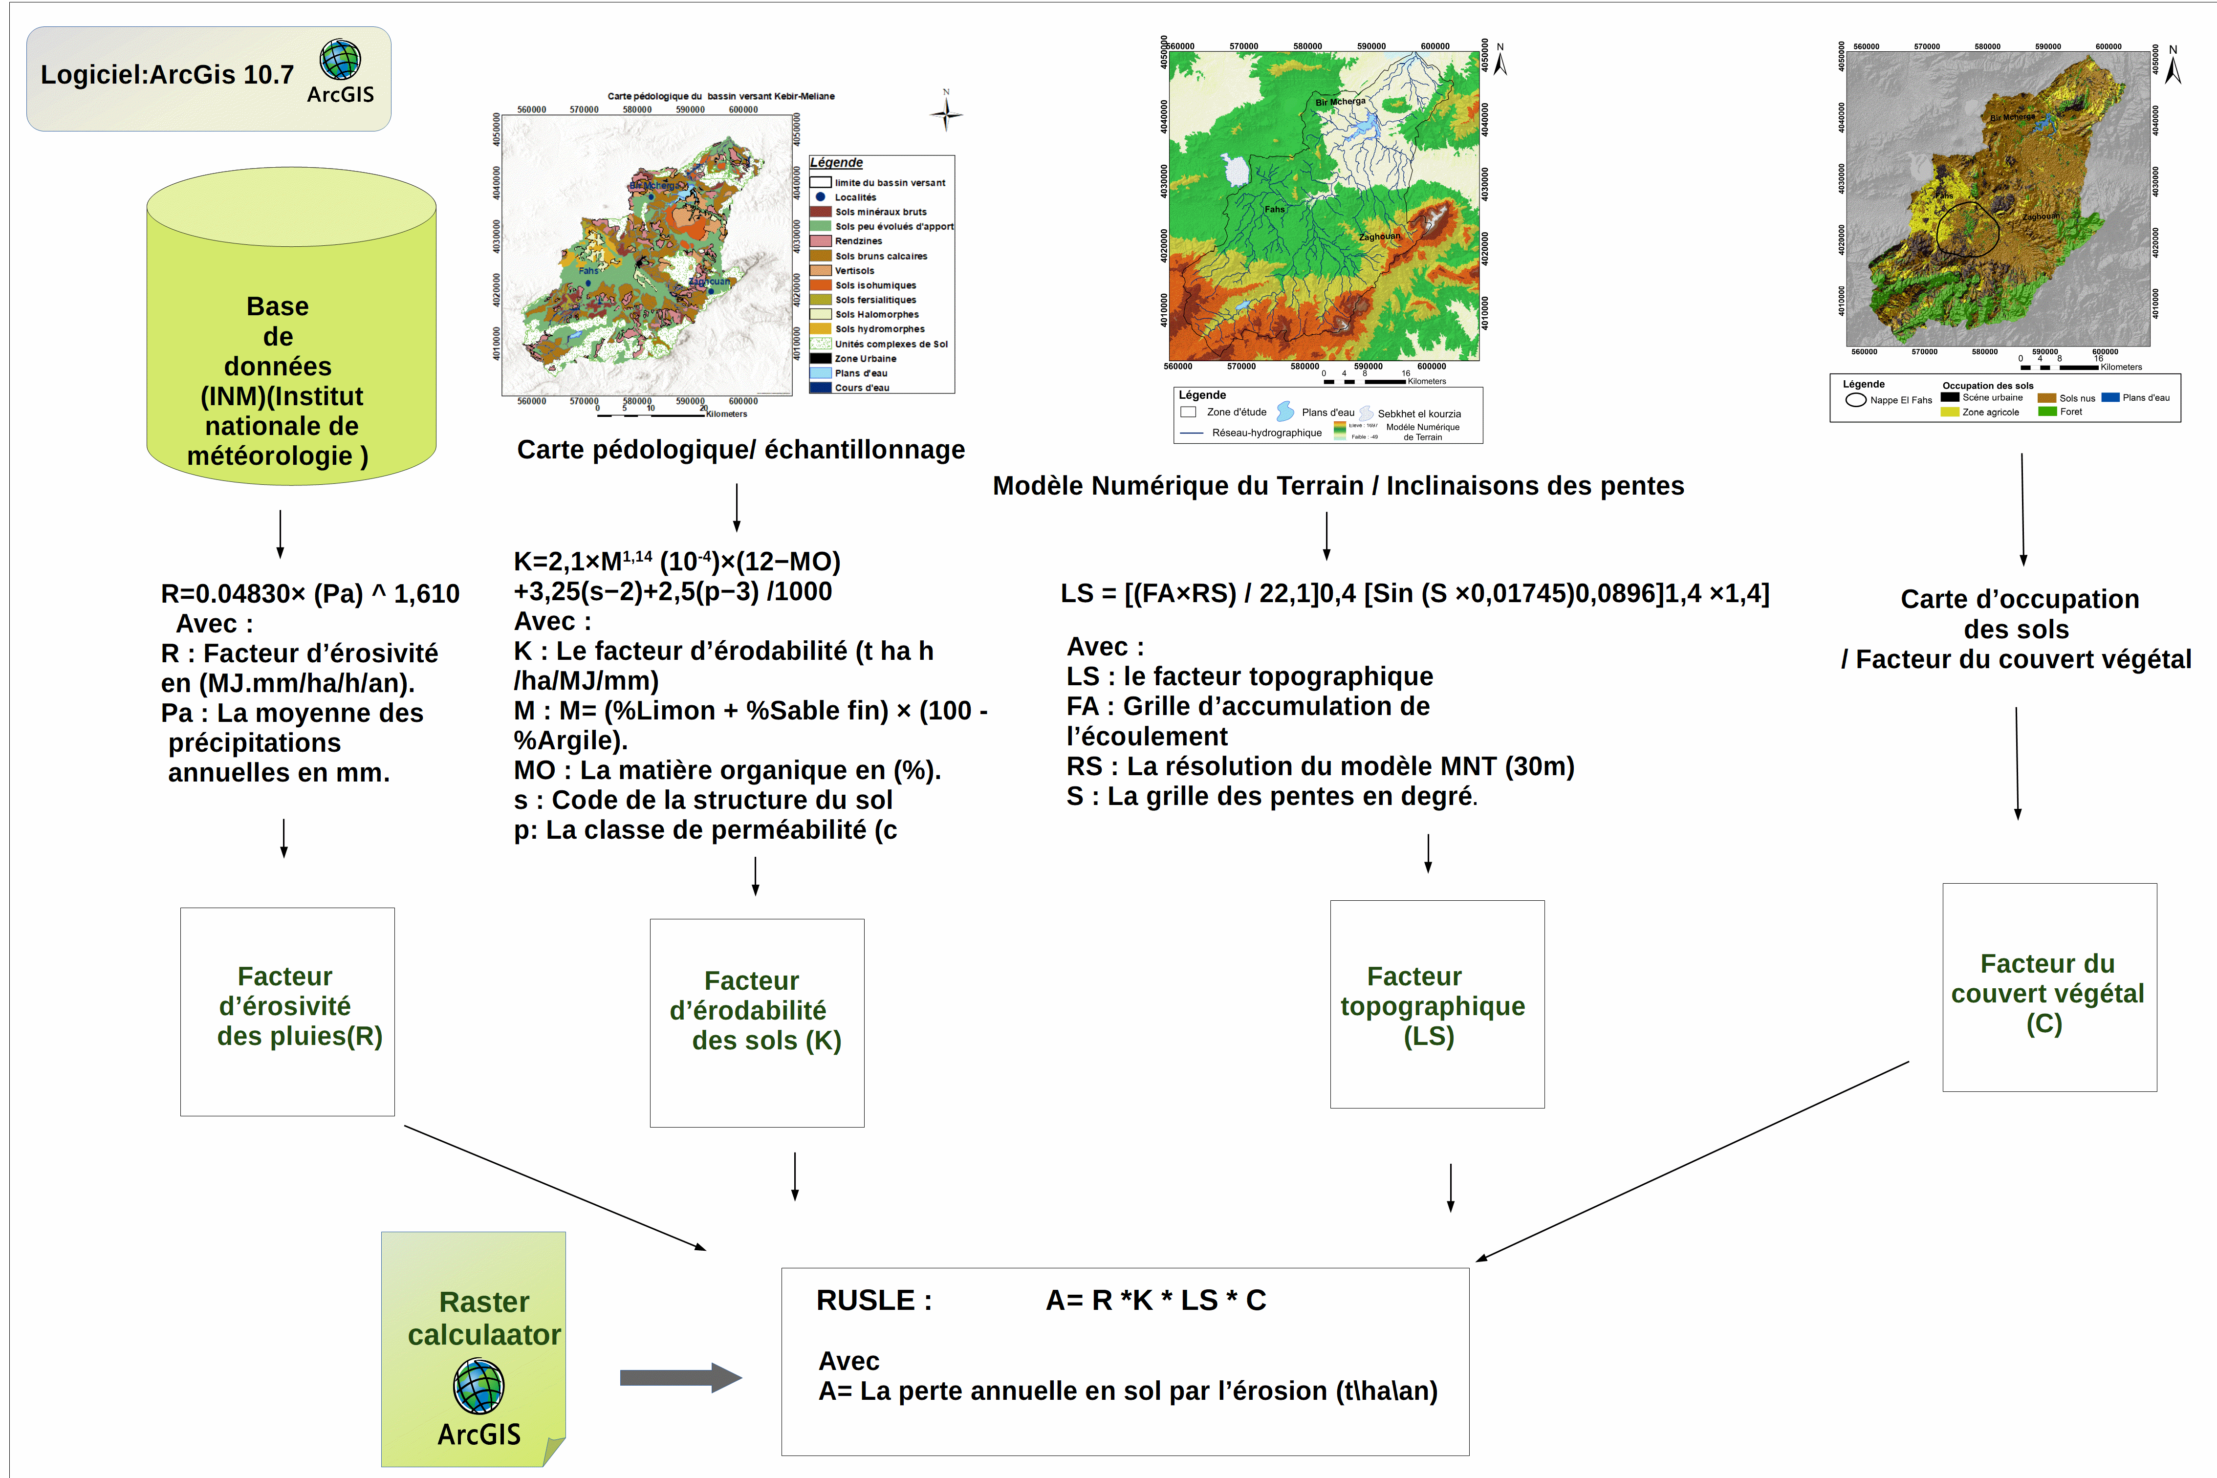
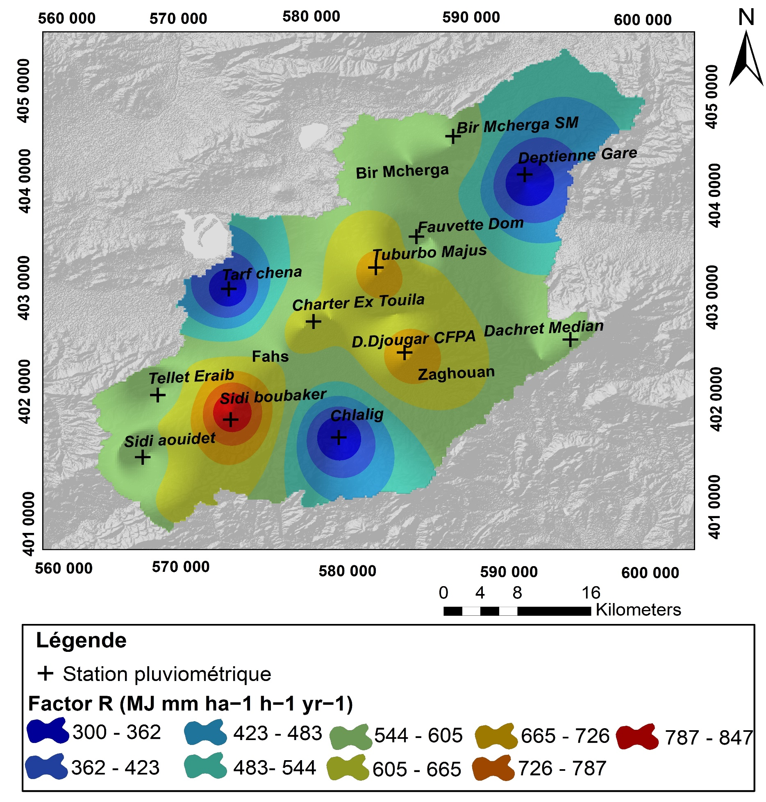
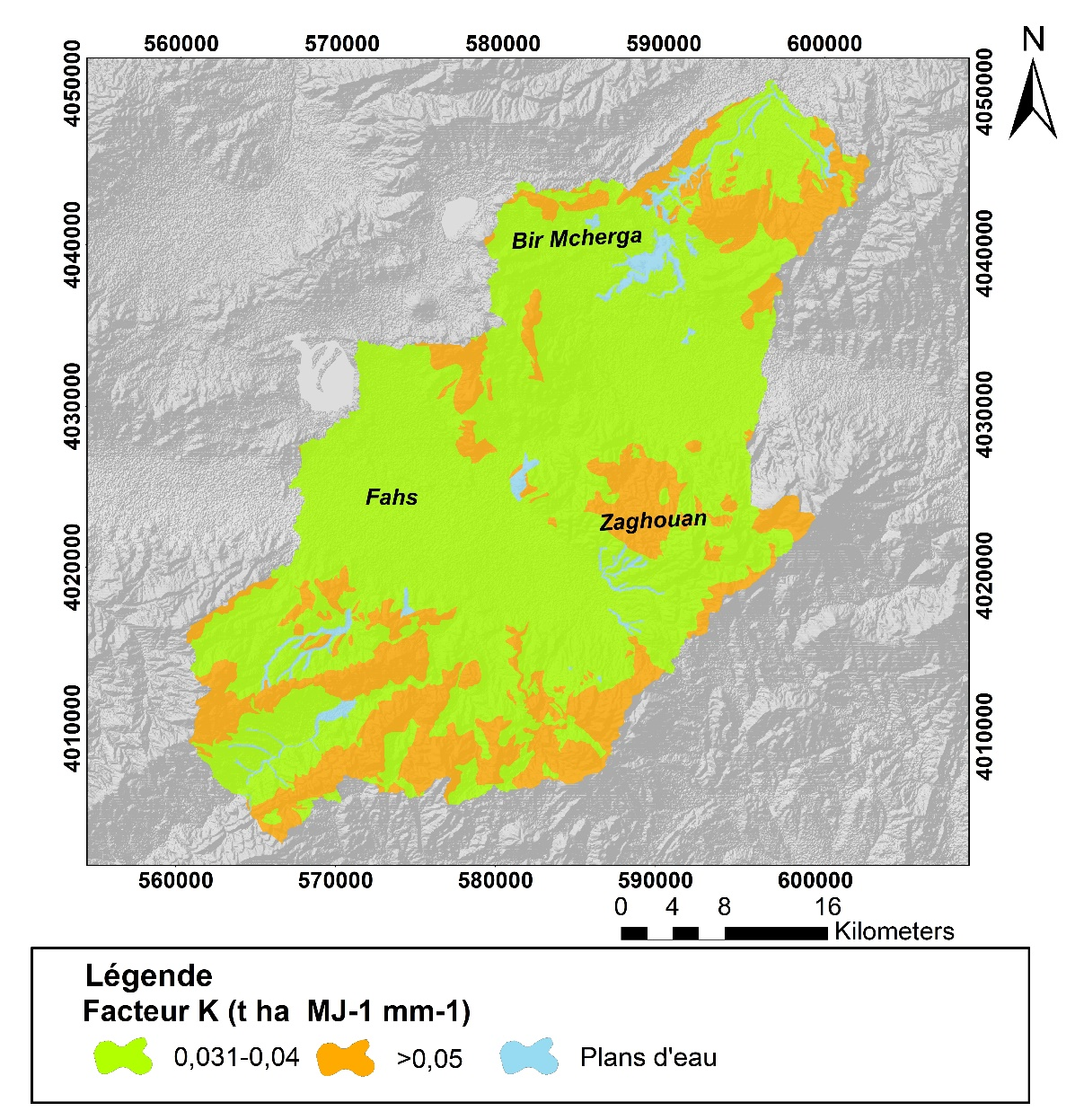
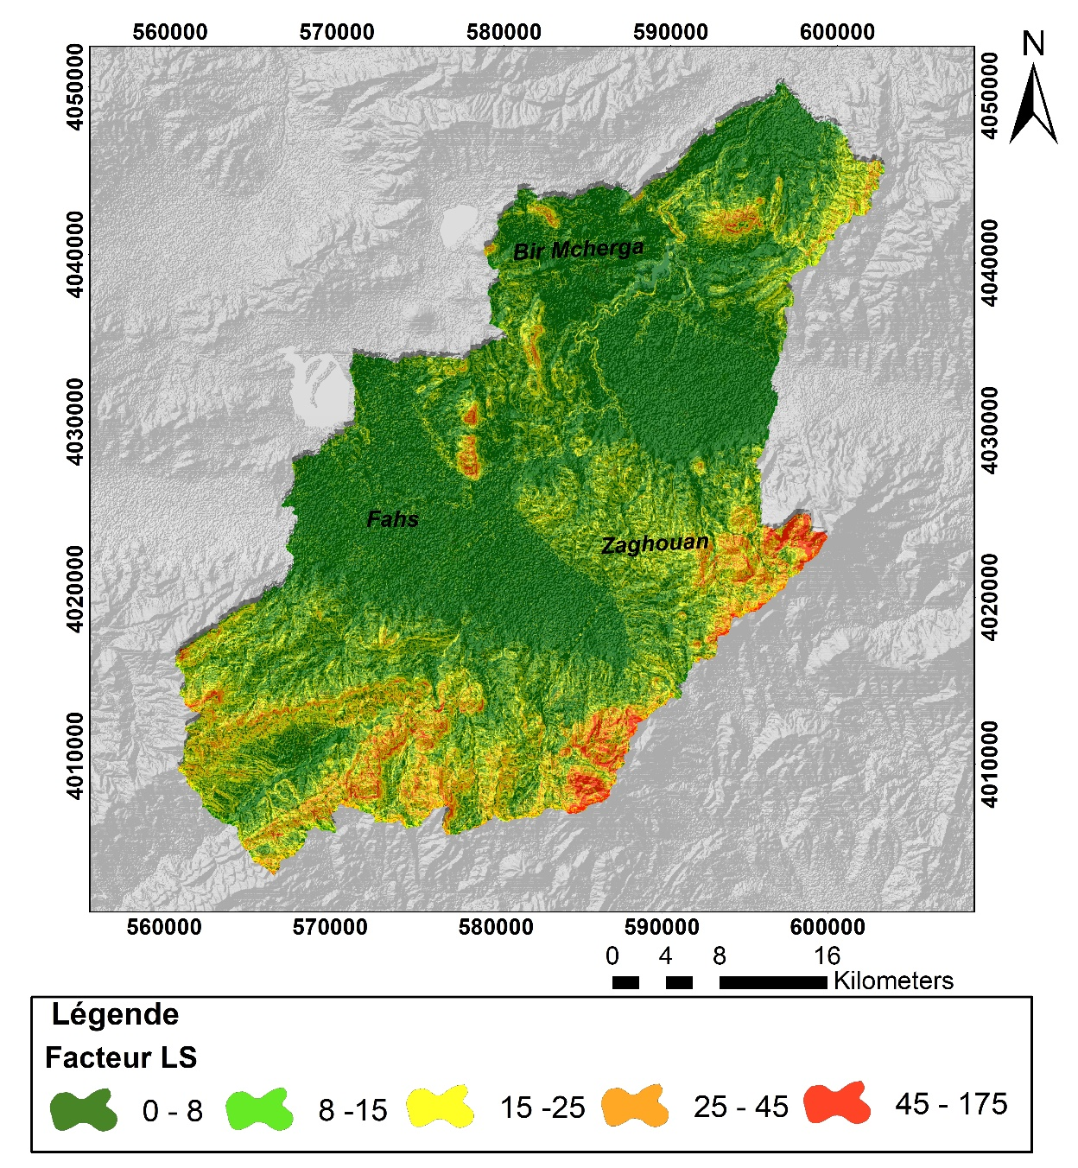
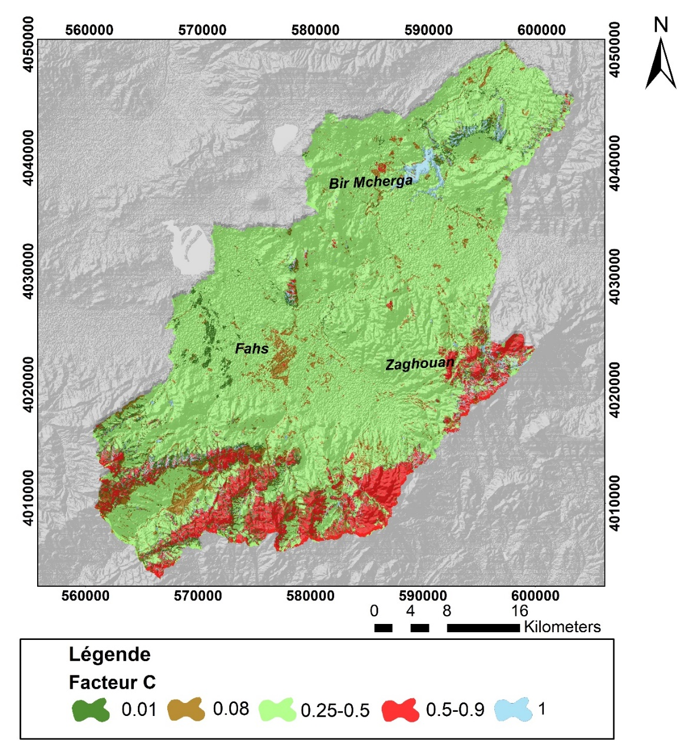
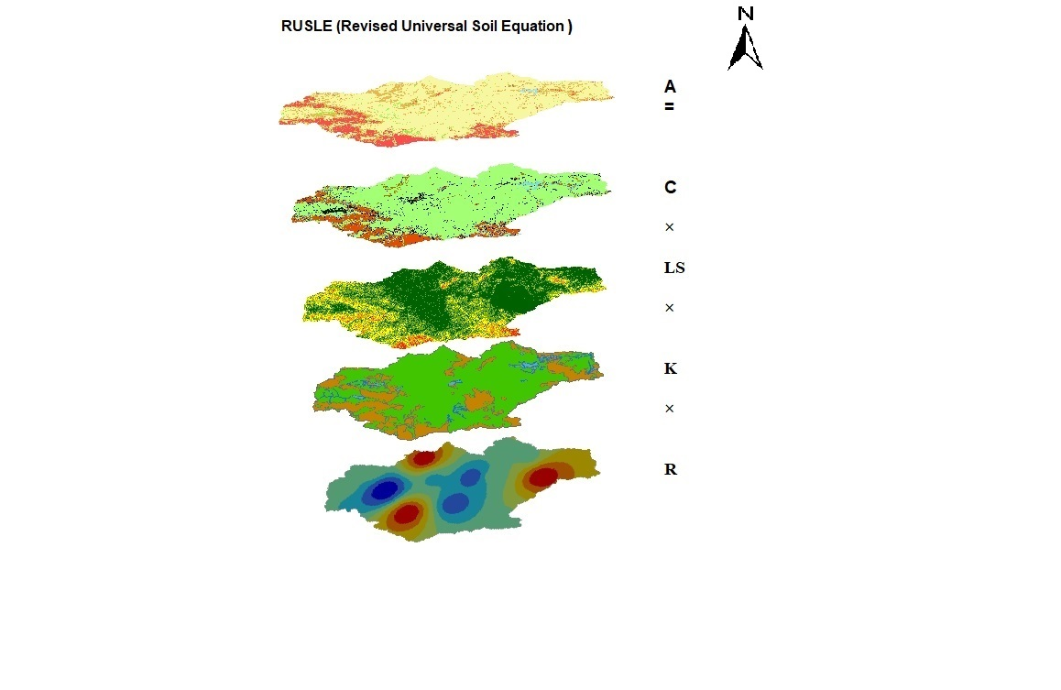
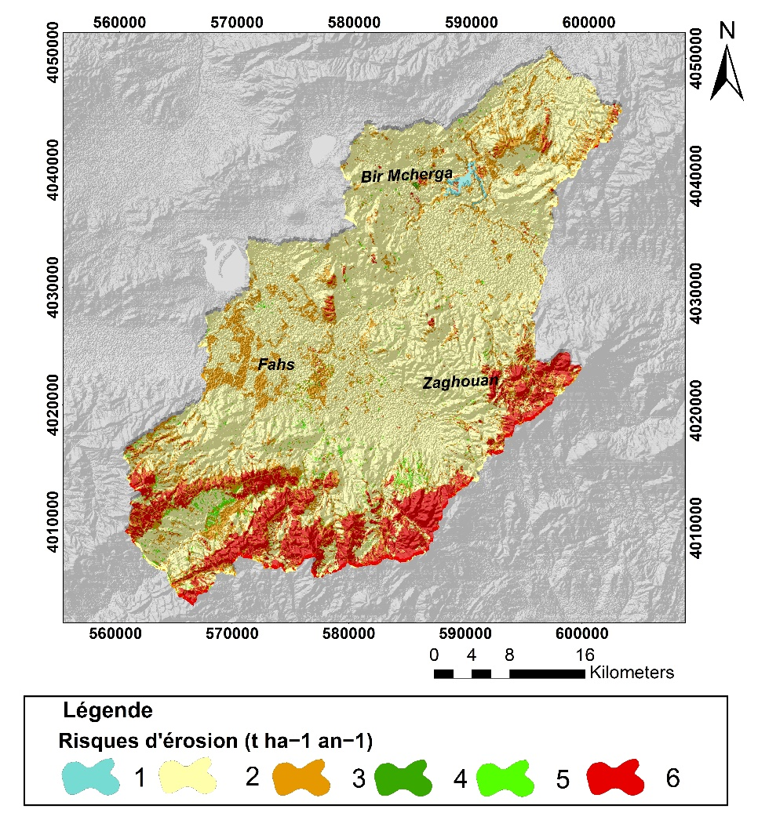
The Third Edition of International ISEE GEOMATICS
TIMELINE GEOMATICS!
ARTIFICIAL INTELLIGENCE ROLE &CLIMATE CHANGE IMPACT
30 th October – 1 st November 2023,, Hammamet - TUNISIA
Your Title is here (DaytonaPro-Bold, size:50)
Your Title is here (DaytonaPro-Bold, size:50)
Your Title is here (DaytonaPro-Bold, size:50)
Author name (1), Author name (2), Author name (3), Author name (4)
www.2023.isee-geomatics.com
www.atg.geomatique.com.tn
Laboratory/Center name, University name, Country
Laboratory/Center name, University name, Country
Laboratory/Center name, University name, Country
Laboratory/Center name, University name, Country
*name@corresponding-author.com
Paper num°
Abstract
Your abstract is here, Your abstract is here Your abstract is here Your abstract is here Your abstract is here Your abstract is here Your abstract is here Your abstract is here Your abstract is here Your abstract is here Your abstract is here Your abstract is here Your abstract is here Your abstract is here Your abstract is here Your abstract is here Your abstract is here Your abstract is here Your abstract is here Your abstract is here, Your abstract is here Your abstract is here Your abstract is here Your abstract is here Your abstract is here Your abstract is here Your abstract is here Your abstract is here Your abstract is here Your abstract is here Your abstract is herev Your abstract is here Your abstract is here Your abstract is here Your abstract is here Your abstract is here Your abstract is here Your abstract is here Your abstract is here Your abstract is here Your abstract is here, Your abstract is here Your abstract is here Your abstract is here Your abstract is here Your abstract is here Your abstract is here Your abstract is here Your abstract is here Your abstract is here Your abstract is here Your abstract is here Your abstract is here Your abstract is here Your abstract is here Your abstract is here Your abstract is here Your abstract is here Your abstract is here,
Introduction
Material and methods
Your introduction is here, Your introduction is here, Your introduction is here, Your introduction is here Your introduction is here, Your introduction is here,Your introduction is here, Your introduction is hereYour introduction is here, Your introduction is here Your introduction is here, Your introduction is hereYour introduction is here, Your introduction is hereYour introduction is here Your introduction is here Your introduction is here Your introduction is here Your introduction is here
Fig.1 : Map of geolocalisation of X region
Results
Fig.2: Flow chart representative of the methodology
adopted
(1)
Your result is here
(4)
(2)
(3)
Result 4
Result 1
Result 2
Result 3
Fig.3: map of the result 3
Fig.4: map of the result 2
Fig.5 :map of the result 3
Fig.6: map of the result 4
Discussion
Your discussion is here, Your discussion is here Your discussion is here Your discussion is here Your discussion is here Your discussion is here Your discussion is here Your discussion is here Your discussion is here Your discussion is here Your discussion is here Your discussion is here Your discussion is here Your discussion is here Your discussion is here Your discussion is here Your discussion is here Your discussion is here Your discussion is here Your discussion is here
(5)
Fig.7 : Maps crossing
Fig.8: Map of the result 5
Conclusion
References
Your conclusion is here, Your conclusion is here Your conclusion is here Your conclusion is here Your conclusion is here Your conclusion is here Your conclusion is here Your conclusion is here Your conclusion is here Your conclusion is here Your conclusion is here Your conclusion is here Your conclusion is here
[1] Wald L., Monget J.M., 1982 : Remote sensing of the sea-state using the 0.8-1.1 micron channel. International journal of remote sensing in press.
[2] Barhoumi. B. 2014. Biosurveillance de la pollution de la lagune de Bizerte (Tunisie) par l’analyse comparée des niveaux de contamination et de l’écotoxicité des sédiments et du biote. (Bizerte), 15-23pp. .
[3] Najoui Z., 2017. Prétraitement optimal des images radar et modélisation des dérives de nappes d'hydrocarbures pour l'aide à la photo-interprétation en exploration pétrolière et surveillance environnementale. Thèse de Doctorat Université Paris Est.

